Slide 1





JENSONS
USA
Data Analysis Using Advanced SQL
Ethen D’Costa

Slide 2

Agenda
About the Company | 3
Aim of the Project | 4
Project Goals | 5
Queries to Optimize Store and Staff Performance | 6
Queries to Enhance Customer Experience | 10
Queries to Improve Inventory Management | 13
Key Insights | 21
Recommendations | 22
Connect With Me | 23

Slide 3




About the Company
Founded: 1994
Focus: America’s best online cycling store with over 30,000 products
Locations: Corona and Riverside, CA
Mission: To be the best for customers, vendors, and employees
Recognition: Internet Retailer Top 500 and Top Workplace in the Inland Empire

Slide 4


Aim of the Project
As a data analyst at Jenson's, craft SQL queries to derive insights on customer behavior, staff performance, inventory management, and store operations.

Slide 5




OPTIMIZE STORE AND STAFF PERFORMANCE:
By analyzing sales data and staff activity, we can identify top-performing stores and employees, as well as areas for improvement, leading to enhanced productivity and operational efficiency.
Project Goals
ENHANCE CUSTOMER EXPERIENCE:
This project aims to optimize performance, enhance customer satisfaction, and improve inventory management through data-driven insights.
Understanding customer spending patterns and preferences allows us to tailor marketing strategies and improve product offerings, ultimately increasing customer satisfaction and loyalty.
IMPROVE INVENTORY MANAGEMENT:
By tracking product sales, identifying top-selling items, and managing inventory levels, we can reduce waste, prevent stockouts, and ensure that high-demand products are always available.

Slide 6

Queries to Optimize Store and Staff Performance

Slide 7

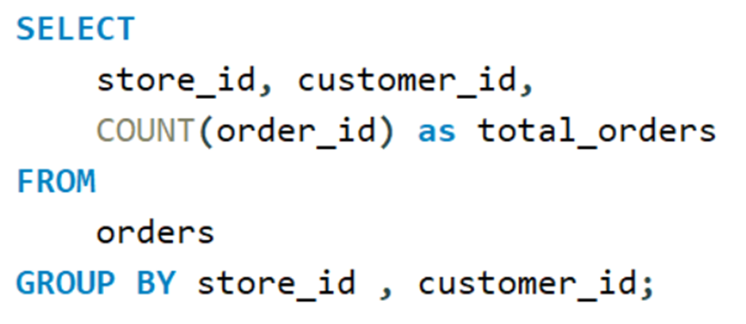
Find the total number of orders placed by each customer per store.

Slide 8

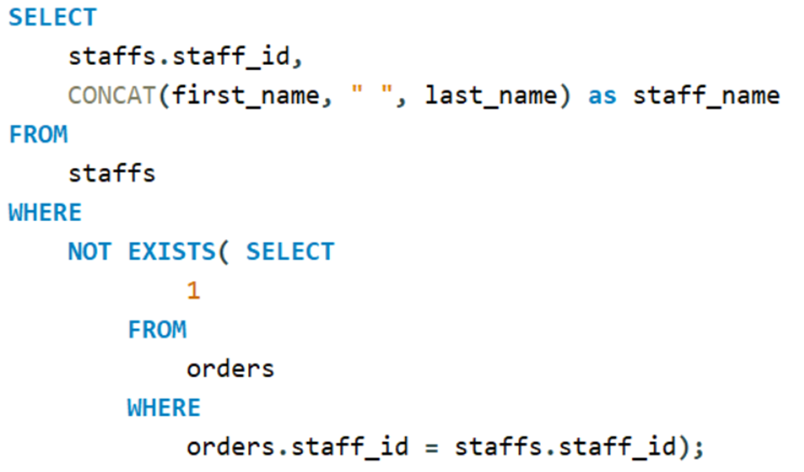
Find the names of staff members who have not made any sales.

Slide 9

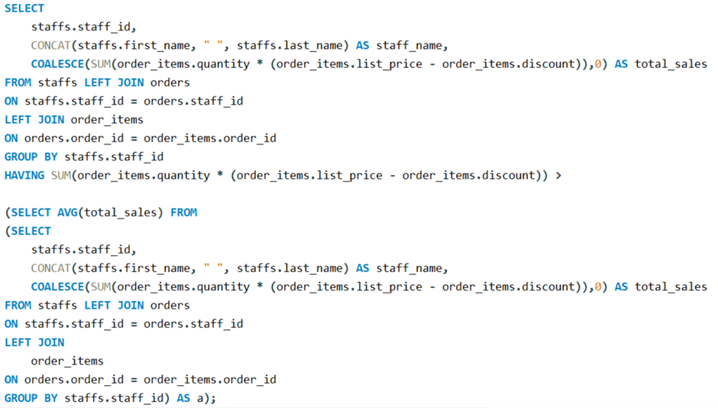
List the names of staff members who have made more sales than the average number of sales by all staff members.

Slide 10

Queries to Enhance Customer Experience

Slide 11
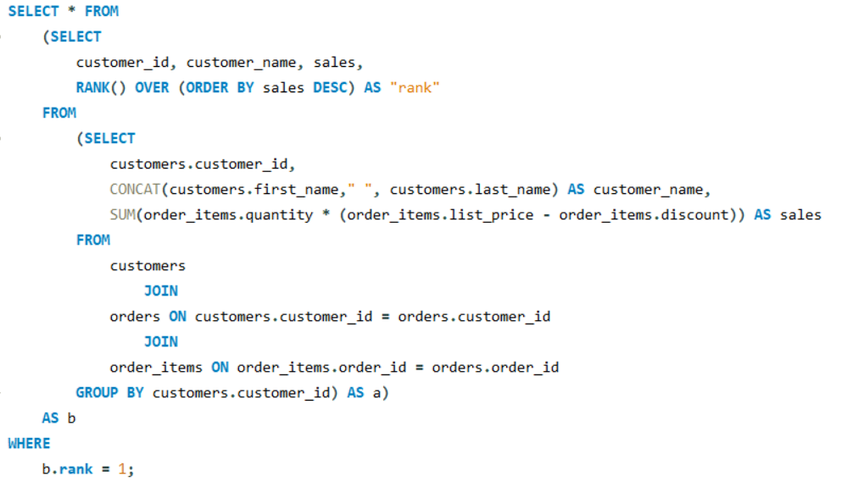

Find the customer who spent the most money on orders

Slide 12
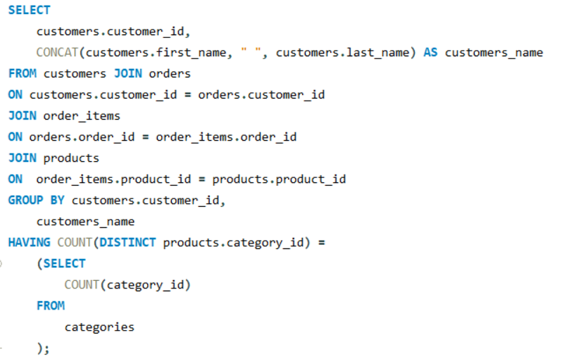

Identify the customers who have ordered all types of products (i.e., from every category).

Slide 13
Queries to Improve Inventory Management

Slide 14
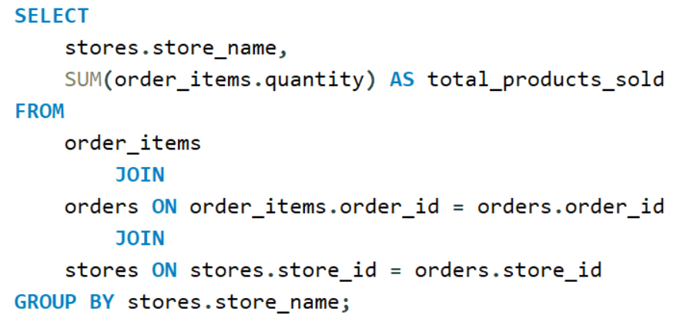
Find the total number of products sold by each store along with the store name.

Slide 15
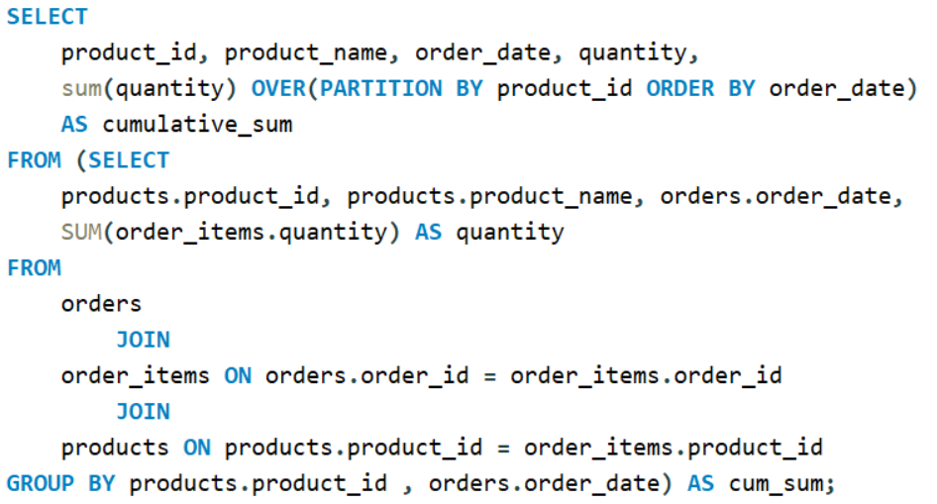
Calculate the cumulative sum of quantities sold for each product over time.

Slide 16
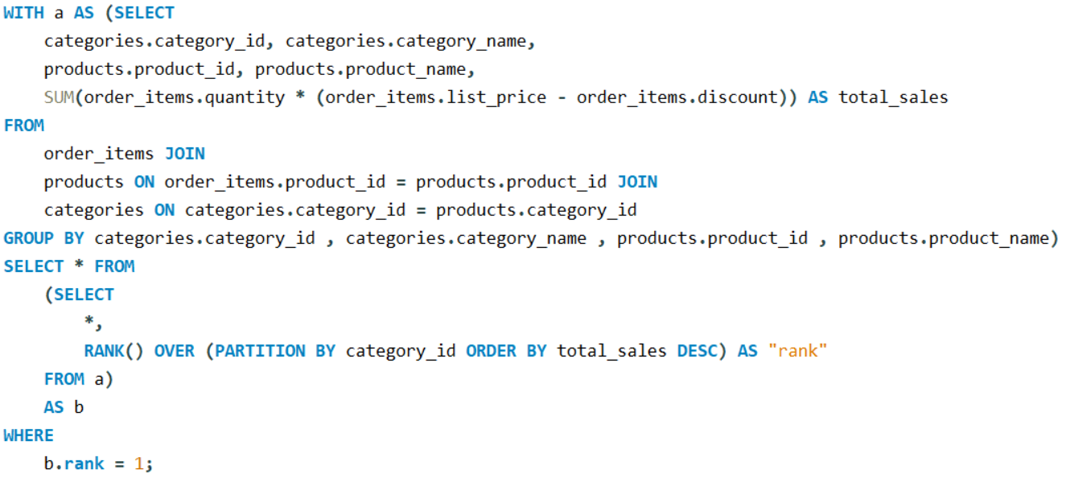
Find the product with the highest total sales (quantity * price) for each category

Slide 17
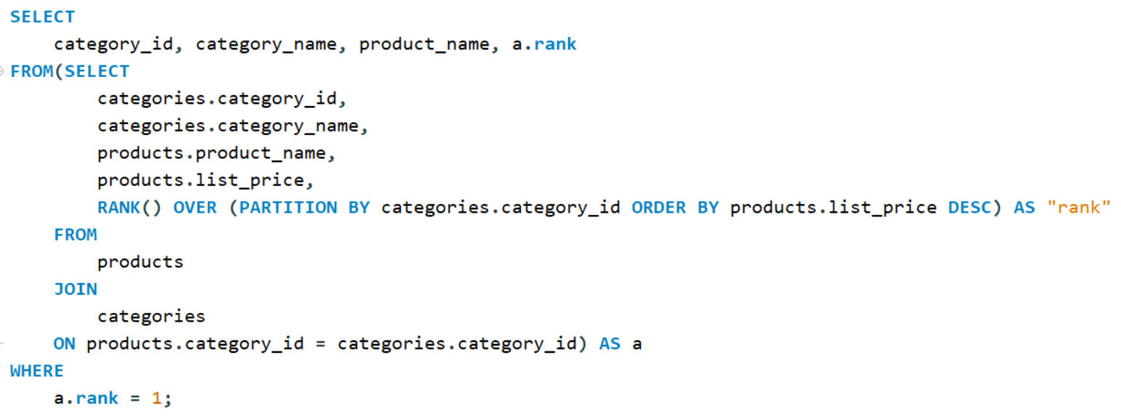
Find the highest-priced product for each category name.

Slide 18
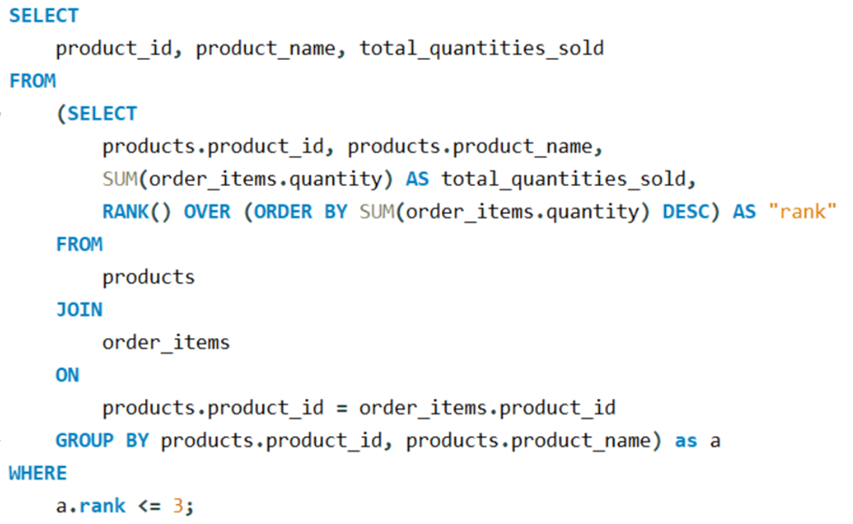
Find the top 3 most sold products in terms of quantity.

Slide 19

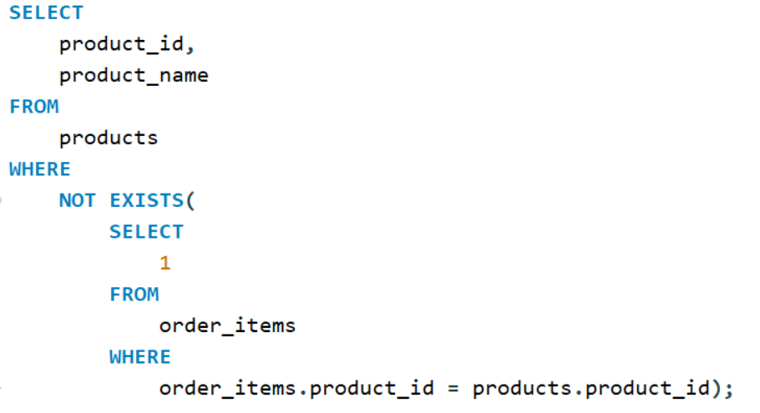

List all products that have never been ordered.

Slide 20
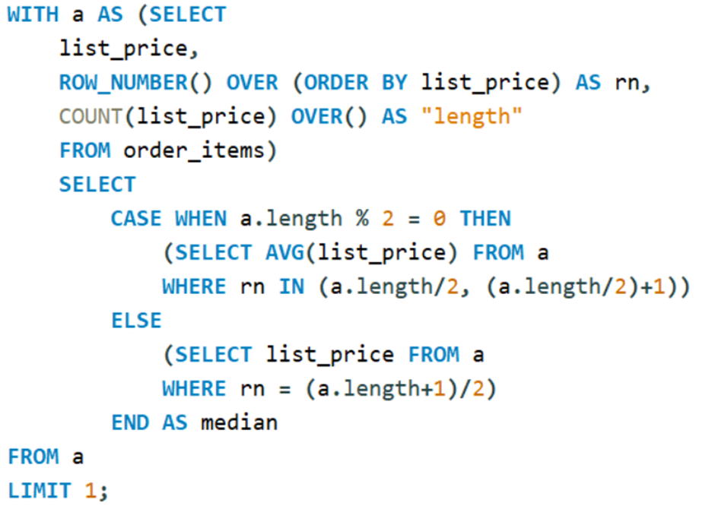
Find the median value of the price list.

Slide 21
Key Insights
OPTIMIZE STORE AND STAFF PERFORMANCE:
Staff Performance: Identifying staff members who haven't made any sales can help focus on areas for improvement, such as training or reassignment.
Top Performers: Staff who exceed the average number of sales can be rewarded or recognized, encouraging continued high performance.
Customer Orders: Analyzing the number of orders placed by customers at each store reveals which stores are more popular or which staff are more effective.
ENHANCE CUSTOMER EXPERIENCE:
High-Spending Customers: Identifying customers who spend the most helps in tailoring exclusive offers or loyalty programs to retain these valuable clients.
Comprehensive Shoppers: Customers who purchase from every product category are likely to be highly engaged, presenting an opportunity for targeted marketing.
IMPROVE INVENTORY MANAGEMENT:
Product Sales: Tracking the total number of products sold at each store ensures that inventory levels align with customer demand, reducing waste and preventing stockouts.
Top Products: Knowing which products have the highest sales or are the most sold enables better stocking decisions, ensuring that high-demand items are always available.
Unordered Products: Identifying products that have never been ordered helps in discontinuing low-performing items, optimizing inventory space and costs.

Slide 22
Recommendations
Optimize Store and Staff Performance:
Implement Targeted Training: Provide additional training for staff members who have not made any sales to improve their performance.
Incentivize Top Performers: Establish a reward system for staff members who exceed the average sales, encouraging others to improve their sales efforts.
Focus on Underperforming Stores: Investigate and address the reasons behind lower performance in certain stores to boost overall efficiency.
Enhance Customer Experience:
Personalized Marketing: Use insights on high-spending and engaged customers to develop personalized marketing campaigns and offers, enhancing customer retention.
Customer Loyalty Programs: Implement or enhance loyalty programs targeting customers who shop across multiple categories to further engage them.
Improve Inventory Management:
Optimize Stock Levels: Adjust inventory based on the sales data to ensure that popular items are always in stock while minimizing excess inventory of less popular items.
Discontinue Underperforming Products: Consider phasing out products that have never been ordered to free up inventory space for more profitable items.

Slide 23

Connect with me.
Looking forward to connecting!
EMAIL | ethendcosta5@gmail.com
GITHUB | https://github.com/EthenDcosta5
LINKEDIN | www.linkedin.com/in/ethendcosta

